Slide 1
Abstract Syntax Tree Generation
Programming Languages
Lecture 5
Adeesha Wijayasiri

Slide 3
Building Derivation Trees
Sample Input :
- + i - i * ( i + i ) / i + i
derivation tree construction:
Bottom-up.
On each pass, scan entire expression, process operators with highest precedence (parentheses are highest).
Lowest precedence operators are last, at the top of tree.

Slide 4

- + i - i * ( i + i ) / i + i

Slide 5
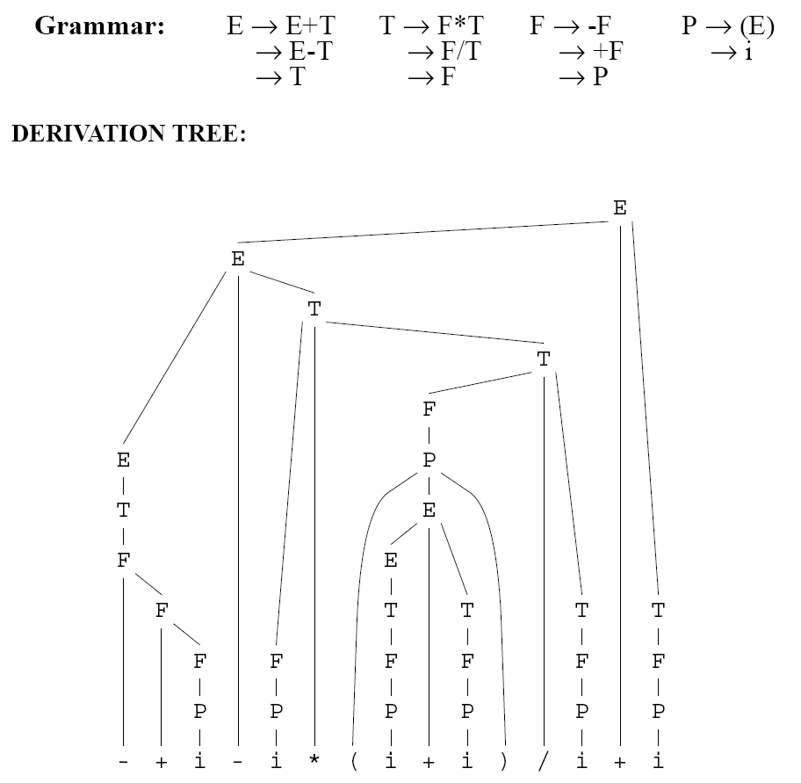

Slide 6
Abstract Syntax Trees
AST is a condensed version of the derivation tree.
No noise (intermediate nodes).
String-to-tree transduction grammar:
rules of the form A → ω => 's'.

Slide 7
Example
E → E + T => +
→ E - T => -
→ T
T → F * T => *
→ F / T => /
→ F
F → - F => neg
→ + F => +
→ P
P → '(' E ')'
→ i => i

Slide 8
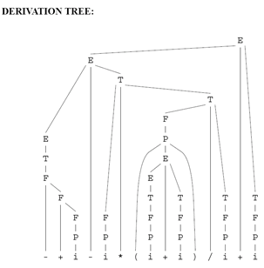

Slide 9
Let's Build a Few Abstract Syntax Trees
Example 1: Factorial.
Example 2: Palindrome.
Example 3: Add numbers from list.
Example 4: Build tuple of pairs of characters.

Slide 10
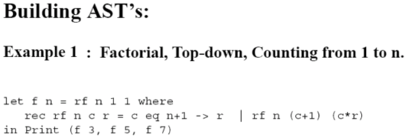

Slide 13
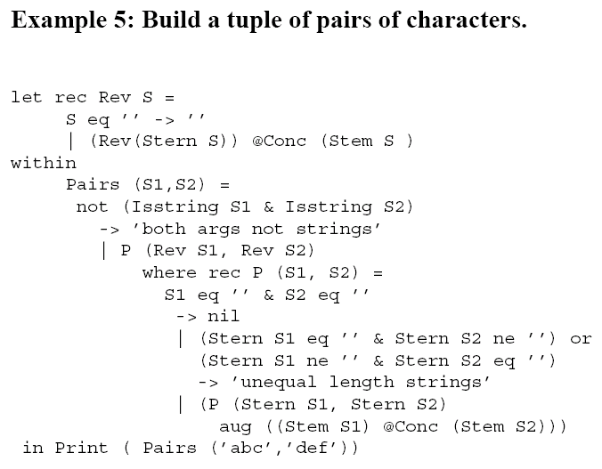
4

Slide 16
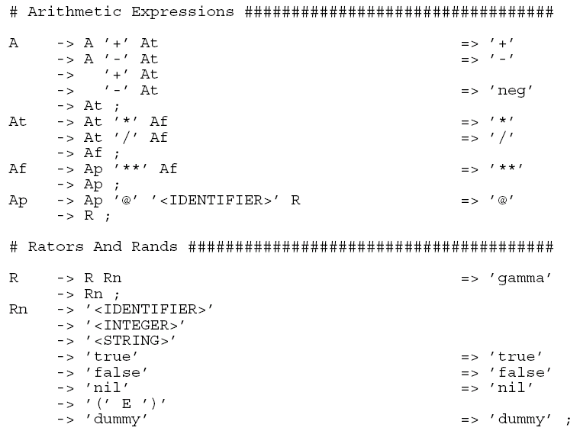

Slide 18
Thank You!

Slide 19
REFERENCES
Programming Language Pragmatics by Michael L. Scott. 3rd edition. Morgan Kaufmann Publishers. (April 2009).
Lecture Slides of Dr.Malaka Walpola and Dr.Bermudez

